Slide 1
Compensation, Incentives, and the Duality of Risk Aversion and Riskiness by Stephen A. Ross
Presented by Andrew Holtzman

Slide 2
Disclaimer
This work is not my own and I do not claim to have any contributions. This is merely my presentation of the paper authored by Stephen A. Ross on executive compensation. I hope you enjoy and please feel free to fact check my presentation with the original paper.

Slide 3
Abstract
“The common folklore that giving options to agents will make them more willing to take risks is false. In fact, no incentive schedule will make all expected utility maximizers more or less risk averse. This paper finds simple, intuitive, necessary and sufficient conditions under which incentive schedules make agents more or less risk averse. The paper uses these to examine the incentive effects of some common structures such as puts and calls, and it briefly explores the duality between a fee schedule that makes an agent more or less risk averse, and gambles that increase or decrease risk.”

Slide 4
Overview of Paper
Section I: Examine two scenarios’ impact on risk aversion, when the fee schedule is a call option and when it is equivalent to a bond position with a short put option.
Section II: General theory for necessary and sufficient conditions in making an agent more or less risk averse.
Section III: How to modify a fee schedule to make an individual less risk averse.
Section IV: Break down the fee schedule into three separate pieces: the convexity effect, the translation effect, and the magnification effect
Section V: explores the duality between a fee schedule that concavifies a utility function and a schedule that makes the underlying payoff riskier

Slide 5
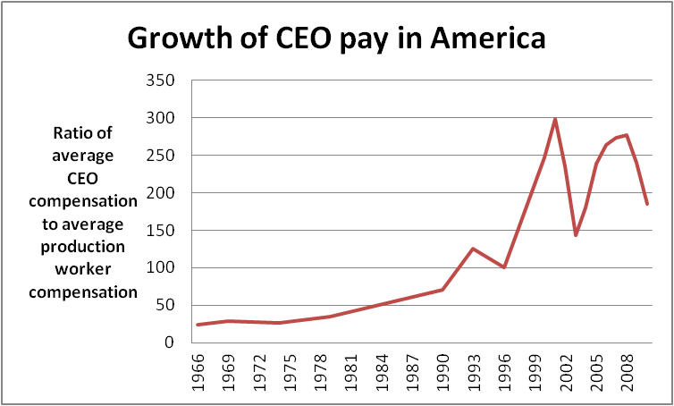
Overview
Executive pay increases have far outpaced corporate profits, economic growth and the average compensation of all workers

Slide 6
Overview
Between 1980 and 2004, Executive pay rose 8.5% per year while corporate profits grew 2.9%, and per capita income grew 3.1%
By 2006 CEOs made 400x more than their average workers
In 1965 CEOs made 20x more than their average workers
10.3% of corporate income was used to compensate CEOs in 2003
Compare this to 4.8% in 1995
Half of a trillion dollars given to top five earning executives at each of the 1500 largest companies in the US from 1994-2004
S&P 500 CEOS average pay was $9.6m in 2011

Slide 7
Section I: Option Fee Schedule
Consider an executive pay package consisting of a fee and stock options (not fungible and must be held to maturity).
Options are advantageous over stock for tax purposes, and since they must be held to maturity, the executive cannot simply sell them after increasing the volatility of the underlying (higher volatility means a more valuable option).
If a convex fee schedule makes agents less risk averse it should hold under:
X is total number of shares, a is total exercise price of options
F(x) = max{x – a, 0}
Notes:
F is the call option function on the value of underlying shares

Slide 8
Section I: Option Fee Schedule
If the agent’s utility function is monotone and concave, it is given by: U(f(x)) = U(max{x – a, 0}) = U(x – a), x >= a, and = U(0), x <= a
What does this actually mean?
For x <= a the utility function is fixed at U(0)
For x >= a it rises as the original utility function
For x > a the result depends on whether U(x – a) is less risk averse than U(x), so it depends on whether x has increasing or decreasing risk aversion
Notes:
U is the agent’s utility

Slide 9
Section I
If a > 0 and U has decreasing risk aversion, then U(x – a) will be more risk averse than U(x)
That said, the value of a call option is an increasing function of the volatility of the underlying, but derived utility is not always less risk averse than U(x)
This presents a paradox that can be resolved by two effects: the convexity effect and translation effect
Convexity of call option schedule makes risky bets more desirable, but this also shifts the domain of an agent’s utility function

Slide 10
Section I
In plain English let’s break this down
A division manager will likely have a year end bonus that is tied to some accounting metric as a performance measure with a floor and a ceiling
If the metric is currently close to the ceiling, the manager may manipulate things so that the metric hits the ceiling, rather than being in range of the floor and ceiling and proportional to the performance indicator
It is unclear that the manager would be more risk averse toward earnings and be unwilling to risk falling below the ceiling

Slide 11
Section I
Consider a junior bond. If the payout option is proportional to the performance indicator, then volatility would decrease the value of the bond near its principal payout i.e. value would decline with increases in volatility
Illustrated by the following where b is a fixed fee and a is the exercise price of a put option
F(x) = b – max{a – x, 0} = min{b – a + x, b}
In the example above, x represents the performance indicator, b is the maximum payout, and a is the level where the payout maxes out
U(f(x)) = U(min{b – a + x, b}) = U(b – a +x), x < a, and U(b) >= a

Slide 12
Section I
Despite a concave fee schedule, whether U(f(x)) is more risk averse than U(x) depends on the region of the domain U moves to (more or less risk averse)
Consider when b – a > 0, the domain is shifted to the right
If U has increasing risk aversion, then it will be more risk averse than U(x), changing the increase in risk aversion at x = a (exercise price)
If U has decreasing risk aversion, x > b – a, U(f(x)) is locally less risk averse than U(x) despite f’s concavity

Slide 13
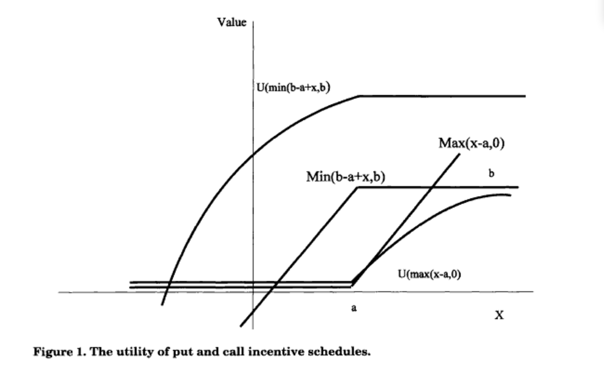
Section I: Option Fee Schedule

Slide 14
Section II: General Theory
The compensation schedule, f, makes a utility function, U, concave if the derived utility of the schedule is more risk averse than the original. On the contrary, if the opposite is true f would cause U to be convex.
This definition is used to characterize fee schedules that increase or decrease risk aversion: U(f) = G(U)
A fee schedule causes a utility function to be concave if and only if there exists a monotone concave function G, such that U(f) = G(U)

Slide 15
Section II: General Theory
Definition 2: A fee schedule, f, convexifies a utility function, if and only if there exists a monotone convex function, G, such that, U(f) = G(U)
Via a long proof we can rearrange to G’’(u)(U’)² = U’(f)f’’[A + f’’/f’ – A(f)f’], where A is the coefficient of absolute risk aversion
Which leads us to Theorem 1: the compensation schedule, f, concavifies (convexifies) U if and only if f’’/f’ = <=(>=) A(f)f’ – A
Corollary 1: The compensation schedule, f, concavifies (convexifies) U for all U only if f is concave (convex)
Corollary 2: There is no compensation schedule that concavifies (convexifies) all U
Notes:
Corollary 2 says there is no fee schedule concavifies or convexifies all monotone concave utility functions

Slide 16
Section II: General Theory
Note DARA are utility functions with decreasing absolute risk aversion, and IARA are utility functions with increasing absolute risk aversion
Theorem 2: The compensation schedule, f, concavifies U in DARA if and only if f is concave, f <= x, and f’ >=1, and it convexifies all U in DARA if and only if f is convex, f >= x, and f’ <= 1. The compensation schedule f concavifies all U in IARA if and only if f is concave, f >= x, and f’ >= 1, and f convexifies all U in IARA if and only if f is convex, f <= x, and f’ <= 1
Notes:
Put simply, Theorem 2 tells us the necessary and sufficient conditions on the fee schedule for it to concavify or convexify DARA and IARA utility functions.

Slide 17
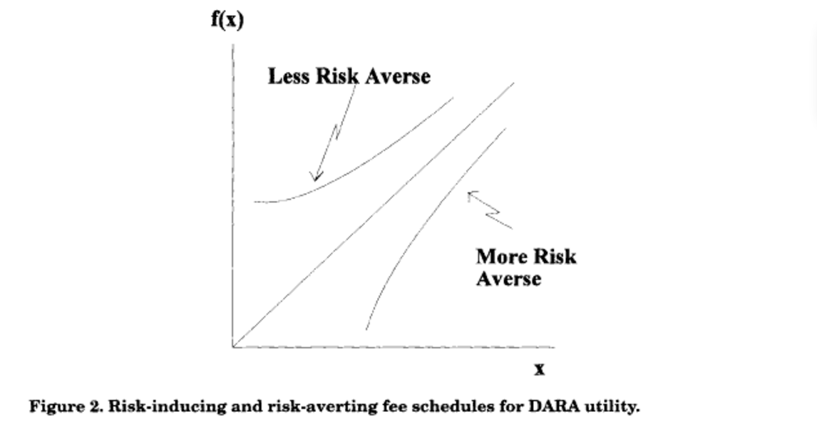
Section II: General Theory
Notes:
Implied shape of compensation schedules for DARA case

Slide 18
Section II: General Theory
Theorem 3: If f in A(dc) or f in A(ic) implies that f concavifies U, the U is DARA or IARA, respectively. If f in A(dx) or f in A(ix) implies that f convexifies U, then U is DARA or IARA, respectively.

Slide 19
Section III
Theorems 2 and 3 need to be modified to fit a real world setting. As they stand, they are the comparison between an agent receiving an entire payoff, x, and receiving some fixed schedule f(x)
Consider when f(x) > x. This would require the executive be paid more than opportunity cost of the company
We can alter the schedule so that f and g satisfy some budget constraint and H is a transformation such that
U(g(f(x))) = H(U(f(x)))
Let z = f(x)
U(g(z)) = H(U(z))

Slide 20
Section III
Corollary 3: Altering an existing fee schedule, f(*), to g(f(*)), concavifies the derived utility function for all U in DARA if and only if g is concave, g <= x, and g’ >= 1, and it convexifies it for all U in DARA if and only if g is convex, g >= x, and g’ <= 1. The alteration g concavifies the derived utility function for all U in IARA if and only if g is concave, g >= x, and g’ >= 1, and g convexifies it for all U in IARA if and only if g is convex, g <= x, and g’ <= 1
Notes:
In this case options are seen as an alternative to simply raising the salary of the CEO. The CEO’s attitudes towards risk are defined by the shape of the transformation H

Slide 21
Section III
Corollary 4: Let Ag and Af denote the coefficients of absolute risk aversion for g and f, respectively. Adding g to an existing fee schedule, f, concavifies the derived utility function for all U in DARA if and only if Af <= Ag, g <= 0, and g’ >=0, and it convexifies Af <= Ag, g >= 0, and g’ <= 0. The alteration g concavifies the derived utility function for all U in IARA if and only if Af <= Ag, g >= 0, and g’ >= 0 and g convexifies it for all U in IARA if and only if Af <= Ag, g <= 0, and g’ <= 0.

Slide 22
Section III
Example of Corollary 4:
A CEO currently is salaried at $1m and has existing ATM call option grants on one million shares of stock with both a current price and exercise price of $20 per share. The board wants to raise to pay because competitors are doing so, but the shareholders are not supportive of this. The CEO’s annual assessment also shows she is too conservative. The board decides to give her 1m ATM grant calls. This will meet market sentiments and encourage risk right? If the CEO displays characteristics of Corollary 4 i.e. DARA, then the impact of the option grant is ambiguous and may cause more conservative behavior

Slide 23
Section III
What else could the board do?
Transform the current option grant into a collar option by granting puts on 1m shares with exercise price of $10 per share. This means the manager would be protected if the share price dropped below $10, but could gain from stock increases. Under Corollary 4, the manager would be more willing to take risk.

Slide 24
Section IV
What is the impact on a CEO from a call option grant?
First, they already have call options, so more will not likely translate to more risk taking
Second, more options will increase the delta of the total compensation package, so an already risk averse CEO will be even more risk averse
The intuition as follows:
Derived Utility fcn: V(x) = U(f(x))
Translation Effect: A(f) – A(x)
Magnification Effect: A(f)[f’ – 1]
Convexity Effect: A_{f}(x)
Notes:
A is the absolute risk aversion for the various functions described. A_{f} is the absolute risk aversion coefficient of the fee schedule

Slide 25
Section IV
A_{v}(x) – A(x) = Translation Effect + Magnification Effect + Convexity Effect
Whether the derived utility function is more or less risk averse than the original depends on whether the sum of the three effects are is positive or negative
These three are locally independent
In order to understand the these effects, let us consider an example with a utility function having a constant absolute risk aversion, the translation effect disappears since the utility function has the same risk aversion at all points in the domain

Slide 26
Section IV
The magnification effect only depends on whether or not the fee schedule is increasing faster or slower than x
Faster means a positive effect
Slower means a negative effect
Regarding the magnification effect, if f’(x) > 1, then a small gamble at x with a standard deviation of sigma will be magnified to sigma*f’(x)
Raising the risk of the gamble and lowering the agent’s willingness to take it on
When there is a constant absolute risk aversion utility function, while there is no translation effect, the magnification effect is sufficient to offset the convexity effect

Slide 27
Section IV
This is because if f’ >= 0 is sufficiently less than 1, then the magnification effect can be negative enough to exceed the convexity effect
This will result in the agent becoming more risk seeking even with a concave fee schedule.
See P.14 of paper for full mathematical example and proof

Slide 28
Section IV
These effects can take any sign and the resulting derived utility function can be more or less risk averse than the original function
Let us reconsider the example of the CEO from a few slides back. Remember that a put option may convexify a schedule for an agent with decreasing absolute risk aversion
A put option is nonnegative, declining, and convex. The nonnegative aspect adds to wealth and makes the agent less risk averse i.e. translation effect, it is convex from the convexity effect, and it has a negative slope so its addition to payoff will lower the magnification effect

Slide 29
Section IV
Adding call options to the payoff has a positive convexity effect, positive translation effect, and negative magnification effect
Put simply, when the put option is ITM the agent will see even money gambles as less risky, but with call options the gambles appear riskier and lower the agent’s incentive to accept them
Carpenter (2000) if a portfolio manager has a DARA or a CARA utility function and receives call options as compensation, the manager seeks to reduce the volatility of the managed portfolio if the number of call options was increased

Slide 30
Section IV
This suggests that the utility function had been concavified by the addition of call options
From Corollary 4 we know that adding call options to a fee schedule will not concavify all DARA utility functions and we must overcome the local convexity effect
For CARA functions there is no translation effect, so the magnification effect is larger than the convexity effect in this scenario

Slide 31
Section V
Since a fee schedule that concavifies a utility function makes the agent more risk averse, but does NOT make the underlying payoff riskier
Executives that have a cap on their option compensation, do NOT have the same incentives as executives at riskier firms with no cap
A random variable is riskier than another if and only if it is weakly inferior for all monotone, concave utility functions i.e. E[U(y)] <= E[U(x)]
If a function existed then, by duality, it would make any agent more risk averse. Corollary 2 showed that no such schedule exists

Slide 32
Section V
Definition 4: A random payoff y is said to be S-riskier by c (a constant) than a payoff x if and only if x is rejected for some U in S, and, whenever x is rejected by U in S, U prefers c to y, that is E[U(x)] <= U(0) => E[U(y)] <= U(c)
Definition 5: A function f is a risk-inducing transform if for any random x, f(x) is S riskier by f(0) than x
Theorem 4: A function f is an S risk-inducing transform if and only if it concavifies U in S
See page 16 for example and proof

Slide 33
Section V
Theorem 5: The compensation schedule, f, is DARA risk inducing if and only if f is concave, f <= x, and f’ >= 1, and it is IARA risk inducing if and only if f is concave, f >= x, and f’ >= 1

Slide 34
Conclusion
There is not sufficient evidence of the classic idea that a convex fee schedule makes an agent less risk averse and that a concave one induces greater risk aversion
They are necessary conditions for the result to hold for utility functions, but not sufficient
The impact of the fee schedule on the agent’s attitudes towards risk depends not only on the convexity, but also on how it translates the domain of the utility function to a more or less risk averse portions and to the extent to which it magnifies or contracts any gamble at the margin

Slide 35
Conclusion
People often argue that call options make executives more willing to take risk, but this depends on the wealth effect of the option
Increasing the wealth of the executive may move them into a more or less-risk averse portions of the utility function
Options can have a magnification effect that could lead to more risk aversion

Slide 36
My Opinion
An early footnote in the paper for Figure 1 states that they assume the individual is not allowed to make use of a market for fair gambles or a complete market to concavify the utility function
I would argue the executive would in fact have access to a complete market because the options are grants (i.e. there is no transaction cost for the agent) and she has access to insider and public information eliminating asymmetry
This would create a complete market and thus complicate the model

Slide 37
My Opinion
I agree with their assertions about adding a put option or collar to the mix
Call options seem to do less to encourage risk taking and more to encourage stability, while put options would allow the agent to gain from the upside while protecting against the downside if she fails

